Slide 1


Tools, data, code, and sharing
Coding in Public workshop
2024
Copyright © 2021. Created by Computational Social Science Training Team, UK Data Service.

Slide 2
Table of Contents
Modern tools
Command line and code
Documenting data
Deployment and sharing
Q&A
Breakout #3

Slide 3
Modern tools

Slide 4

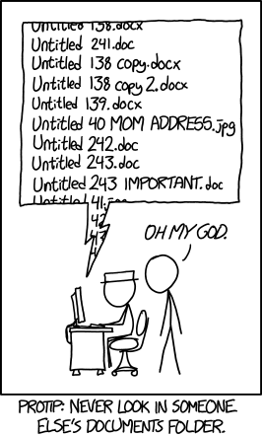
Tools can help prevent this sort of thing.

Slide 5
Tools to help
Online meetings
Recording/auto transcription
Export attendees
Save and export chat
AI summarising/notetaking
M365 suite – all in one solution?
Schedule meetings within a channel to save the chat
Send emails to channels
Save posts as to-do items
Trigger-action services (IFTTT, Zapier, Pipedream, etc.)
Automate actions (export zoom attendees to a spreadsheet in gdrive, etc)
Useful if you need to work across lots of platforms
Requires access to accounts to run
Version control – more on this next

Slide 6
Version control software
Solves a lot of problems
Draft 1, draft 2, final draft 1, final draft 2, etc.
Integrating feedback from multiple users
Central storage
Change log
Lots of options
In M365 (although relatively invisible so some users revert to old patterns)
Git and git-based cloud services
SVN, etc.
Very powerful, not so beginner friendly
Notes:
You have probably heard of git or github.
Git is the version control system and Github is a cloud host that uses git. There are many others such as GitLab, Bitbucket, AWS CodeCommit, etc. We will be using github in some of the breakout sessions today so hold onto your butts.

Slide 7
Version control as a police evidence room
The master version lives centrally
People “check out” copies to work on
The copies are checked back into the master version WITH
Changes, additions, etc.
A message about what was changes/added/etc., and
System stamps saying who checked it in and when
Conflicts (incompatible changes on 2+ check ins) must be resolved
reject all check-in changes from one or the other
compare incompatible changes side by side and reject one at a time
etc.
Good practice = always “check out” newest copy before working
Notes:
People can also “fork” copies, essentially making a new master version, to work separately e.g. to turn this file into a separate thing for a different applicaiton

Slide 8
Other topics
Track tasks
To-do lists/apps
Kanban boards/apps
Automation
Link apps/online services together to chain actions
Choose good triggers and actions based on agreed processes (e.g. when Kanban board ticket is marked as finished, add line to spreadsheet)

Slide 9
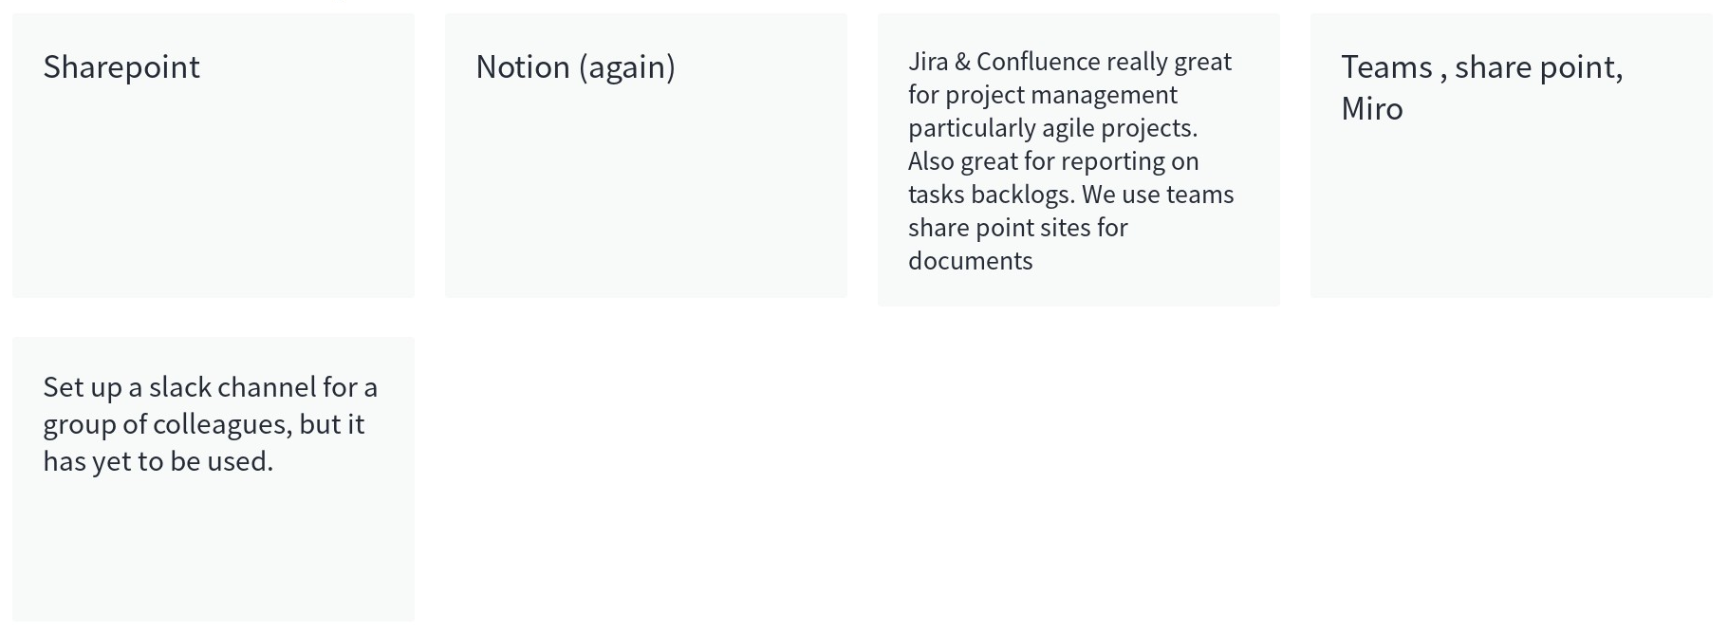
What tools do you like to use for teamwork?

Slide 10
Modern pace of technological change
Tools are made or discontinued at a rapid pace
Software is updated frequently, complicating versions/dependencies
Methods are developed continuously, but are not always very accessible
Plus, cultish adherence/avoidance

Slide 11
Modern tools, modern problems
You can automate the boring stuff to do more than was feasible before
But automated processes can break easily

Slide 12
Ignorance can be fixed, but not everything can
Rapid pace of change and increased complexity mean = lack of skills or knowledge
Fixing this is possible, but not always easy
Openness to change is harder because it is often a (nearly) fixed feature of personality

Slide 13
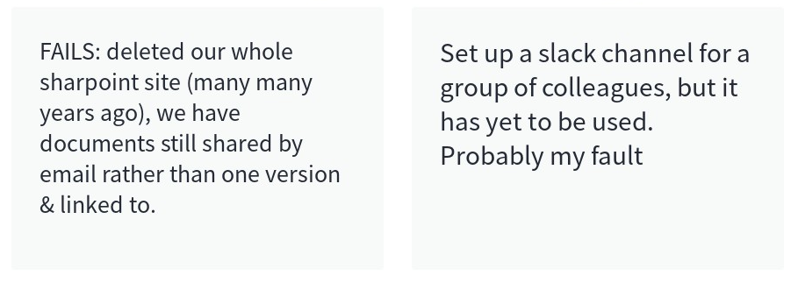
Share some of your wins and/or fails
Notes:
Short answer/discussion about how their experiences.

Slide 14
Consider when choosing collaborative tools
Cloud vs. local
Cross-platform/open source vs. paid/proprietary
Tracked vs. untracked
Written vs. spoken
Visual vs. descriptive
Consider size/speed requirements
Make environments clear (or irrelevant)

Slide 15
Tools for teamwork
Pick (and stick to) good naming conventions and shared locations
ALWAYS leave useful commit comments (if available)
Everyone uses most recent version each time (check out)
Agree in advance (and stick to) a plan for settling conflicts
Notes:
Everyone on a project should understand and agree to a naming convention for shared projects. Maybe put this in the comms plan?
Likewise, everyone should understand, agree to and have access to a central and secure place to put all the project materials.
Ideally, that place would have a version control system (share point has a version control system) and that everyone would understand how to use it.
May need refreshers, formal agreements, prominent comms plan place, etc.
What do these things under version control mean? I’ll explain now.

Slide 16
Command line and code

Slide 17

Shell commands and code can seem scary
This Photo by Unknown Author is licensed under CC BY-SA-NC

Slide 18

But actually…

Slide 19
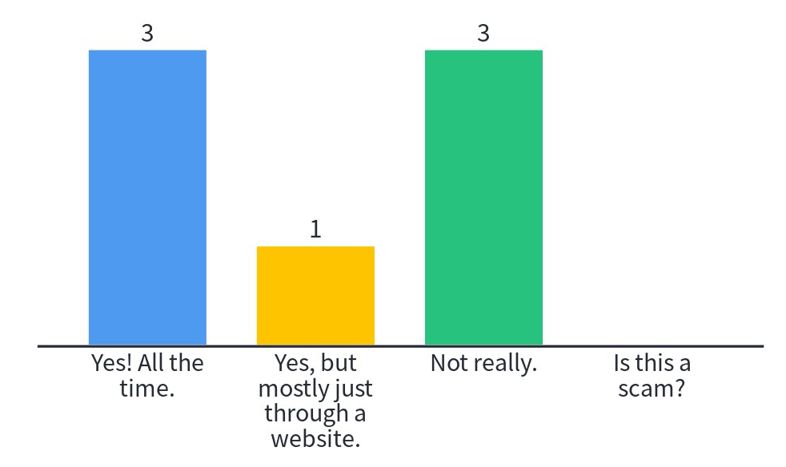
Have you used git?

Slide 20
Key shell commands for git
git pull
git add *
git commit –m”useful commit message here”
git push
git status

Slide 21
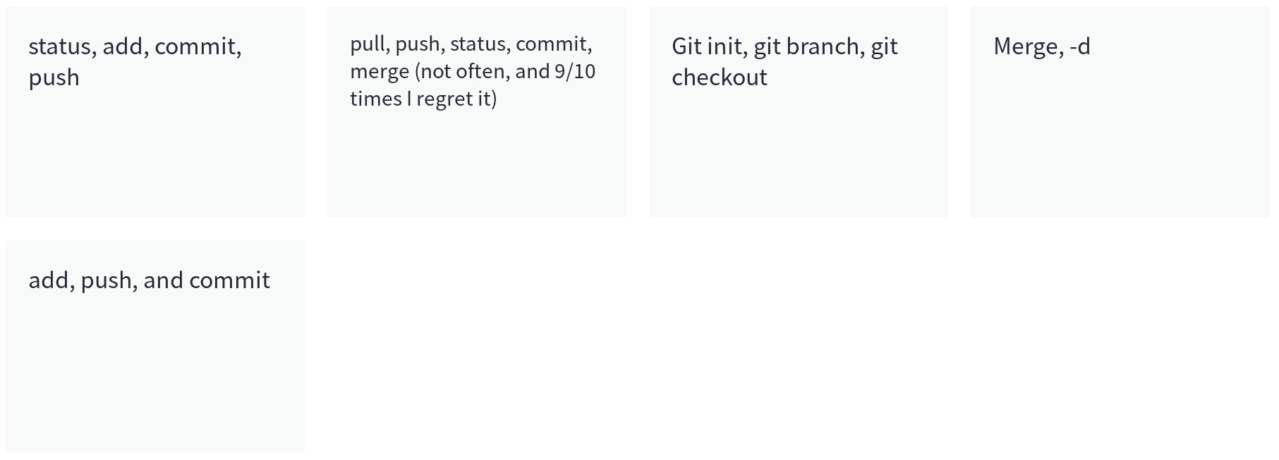
What are your key git commands?

Slide 22
Collaboration, code, version control
Use “comments” in code to:
Declare any useful background info (like author, current project status, software environment, etc.)
Explain what this given line of code does or what it refers to
Ask yourself questions, list steps you want to do next, address whether a functional thing will be upgraded in the future, etc.
Example:
## Basic Coding Example by J. Kasmire
## Python Version- 3.9.5
print("spam and eggs") ## This classic beginner command
## references classic Monthy Python sketches

Slide 23
Code for what, exactly?
All the steps of your process that you possible can do in code
Data collection
Cleaning/prepping
Analysis
Visualisations
Notes:
Code is also called syntax in some software, like SPSS and STATA. Excel macros can also be seen as code-ish.
The syntax approach to these software tools is MUCH more reproducible than point and click, drag and drop, etc. options because the inputs, actions, outputs and the order of each of these are all written down and repeatable.
The alternative is a VERY LABORIOUS hand-written version in which you write all these things down (and correct your hand-written version if you go back and make changes anywhere along the line).

Slide 24
But why code?
By writing your processes in code, you
Are forced to write it correctly/ordered
Can rerun it/generalise it easily
Can share it
Have a head start or methodology section.
Notes:
MUCH MUCH MUCH easier than hand-writing it and MUCH MORE REPRODUCIBLE

Slide 25
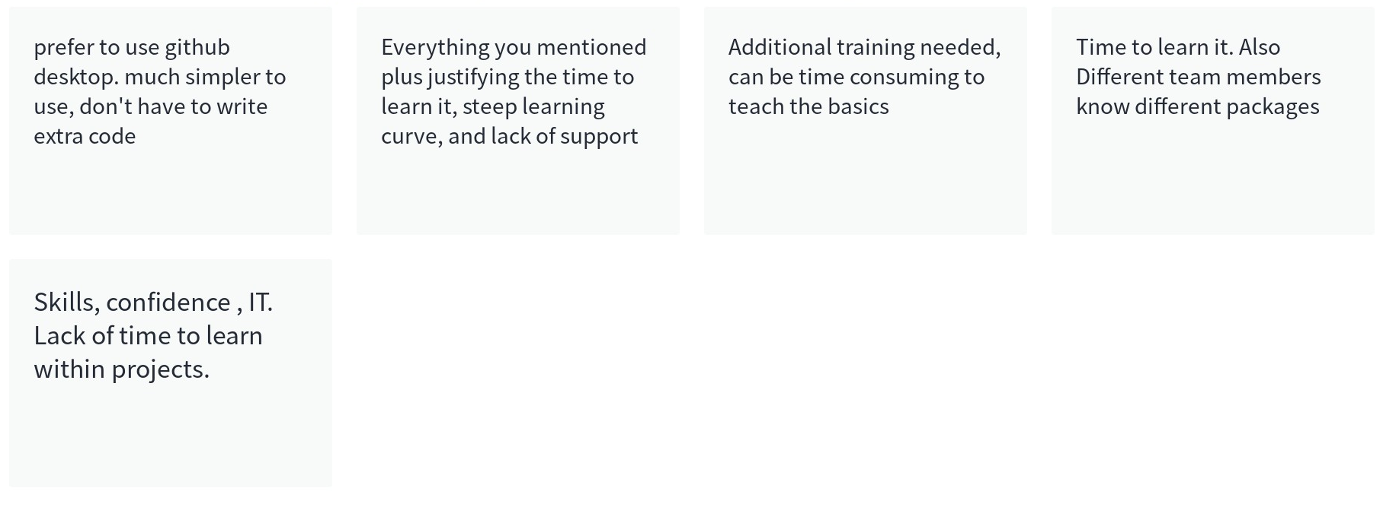
What barriers stop you and your colleagues from using code?
Notes:
Are these barriers equitable?

Slide 26
Where/how should I code?
Coding language appropriate for your project
Cloud with password protect if needed (check GDPR)
Interactive notebooks are ideal (more on this later)
Capture your computational environment (more on this later)
Notes:
What code/syntax does your team use?
What do you want to do with it - e.g. lots of general steps or one specific step? That might help you choose.
Who is likely to see it/use it? Lots of beginners? Only advanced people? Anyone that reads your research article? Only people that go looking for it?
Is your research topic or method focussed?

Slide 27
Coding for teamwork
Pick (and stick to) good naming conventions
ALWAYS leave useful commit comments
Everyone always checks out before working
Agree in advance (and stick to) a plan for settling conflicts
Write in-code comments – LOTS OF THEM!
Use good naming conventions for in-code variables too.
Notes:
Version control is almost ESSENTIAL for collaborative or team coding. It gets REALLY HARD to manage otherwise.
So the first few points are the same as you have already seen. However, there are a few more points that relate specifically to coding collaboratively.

Slide 28
Documenting data

Slide 29
Data sharing – FAIR
Findable – somewhere popular, indexed, well labelled, etc.
Accessible – as open as possible
Interoperable – in a standard format, shape, etc.
Reusable – appropriate meta-data, column names, etc. so it is easy to combine, etc.

Slide 30
Data sharing – Supported locations
Often provide DOI, permanent url or citations
UKDS https://ukdataservice.ac.uk/deposit-data/
UK Data Archive https://www.data-archive.ac.uk/deposit/
OSF https://osf.io/
Mendeley data https://data.mendeley.com/
Field or discipline specific holdings https://www.bgs.ac.uk/geological-data/national-geoscience-data-centre/ngdc-depositing-data/
University or research institute libraries?
Your funding body?

Slide 31
Data sharing – Own locations
More control, but also more responsibility
Github
Personal website
Cloud server space
Own server
You can make your own DOI, permanent link or citation!
QR codes make sharing easy www.qrcode-monkey.com

Slide 32
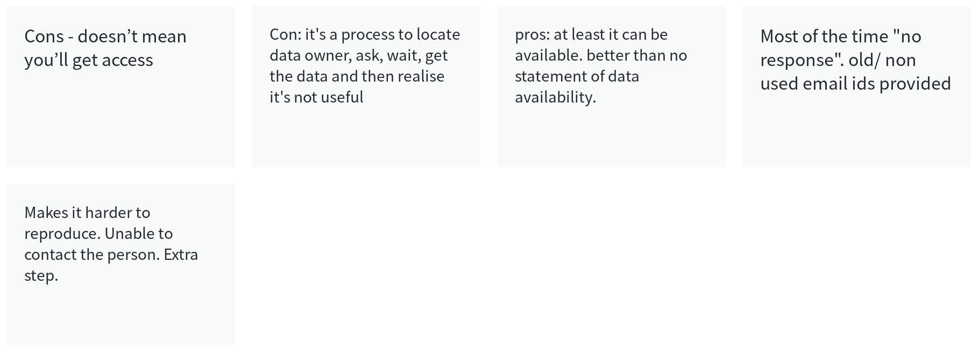
What are pros/cons of “data available on request”?

Slide 33
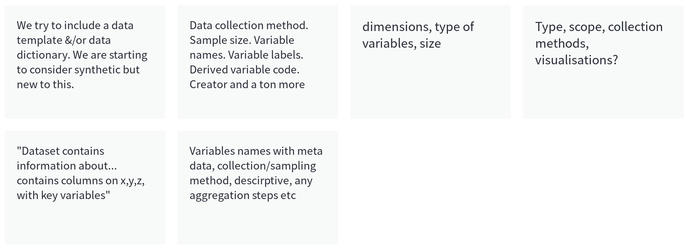
If you can’t share your date, describe it! What is important in a good data description?

Slide 34
Deployment and sharing

Slide 35
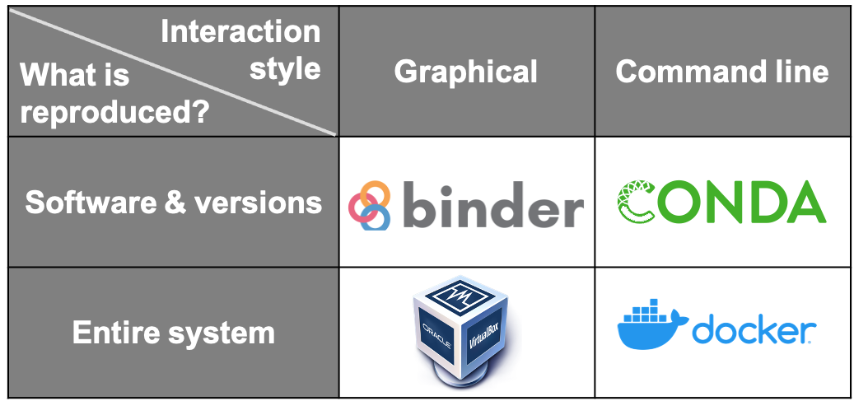
Capture your computational environment
Notes:
Can just manually write down everything (operating system & version, software & version, etc.)
Allow users to inspect/run code without downloading it
The environment is built into the interactive notebook
Can include comments, etc.

Slide 36
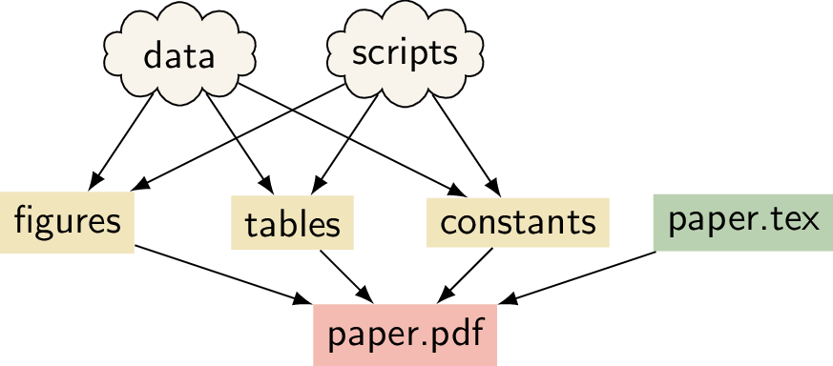
Makefiles
Notes:
With a clever Makefile, you can share a complete analysis (code, data, and computational workflows) and let collaborators or the readers of your paper recompute your results. By using tools such as LaTeX, you can even generate a complete manuscript that includes freshly computed figures and results! This can increase the trust in the research output that you generate, it can make your research more accessible, and it can make collaborating easier. This chapter can show you how to get started.

Slide 37
Interactive notebooks
jupyter notebook, Rmd, etc.
Allow users to inspect/run code without downloading it
The environment is built into the interactive notebook
Can include comments, etc.

Slide 38
Sample jupyter notebook
Go to my arrow of time notebook?

Slide 39
References
UKDS https://ukdataservice.ac.uk/deposit-data/
UK Data Archive https://www.data-archive.ac.uk/deposit/
OSF https://osf.io/
Mendeley data https://data.mendeley.com/
https://www.bgs.ac.uk/geological-data/national-geoscience-data-centre/ngdc-depositing-data/
https://docs.github.com/en/repositories/archiving-a-github-repository/referencing-and-citing-content
https://www.wpbeginner.com/wp-tutorials/how-to-create-custom-permalinks-in-wordpress/
www.qrcode-monkey.com
Data in Government Blog tinyurl.com/Synth-DataInGov
The unreasonable effectiveness of synthetic data with Daeil Kim tinyurl.com/Synth-Podcast
Medium article this webinar is based on tinyurl.com/Synth-Blogpost
The Anonymisation Decision-Making Framework https://msrbcel.files.wordpress.com/2020/11/adf-final-version-3.1-for-uploading.pdf
Synthetic data estimation for the UK longitudinal studies https://calls.ac.uk/output-entry/synthetic-data-estimation-for-the-uk-longitudinal-studies-sylls-project-an-introduction-to-the-multiple-imputation-approach/
Synthetic Datasets for Statistical Disclosure Control: Theory and Implementation: 201 https://www.springer.com/gp/book/9781461403258
https://www.nature.com/articles/s41551-021-00751-8
Make https://the-turing-way.netlify.app/reproducible-research/make

Slide 40
Q&A

Slide 41
Breakout #3
Notes:
Create a file in your github repo. Edit someone else’s file (leaving a good comment).
Update your repo after someone edits your file.

